Slide 1
Big Mountain Ski Resort Case Study for Revenue Growth Juan Yostly May 2024

Slide 2
Market overview
The ski resort industry is expected to grow and register a CAGR of 11.8% during 2024-2029. As per capita disposable income continues to increase, many Americans will likely continue spending on vacations and activities, such as skiing and snowboarding.
IBISWorld anticipates industry revenue to increase at an annualized rate of 3.6% to $3.4 billion over the next five years.

Slide 3
Business objective
Big Mountain suspects it may not be maximizing its returns, relative to its position in the market.
It also does not have a strong sense of what facilities matter most to visitors, particularly which ones they're most likely to pay more for.
What opportunities exist for Big Mountain to increase revenue to at least cover the operating costs of a new lift ($1,540,000)?

Slide 4
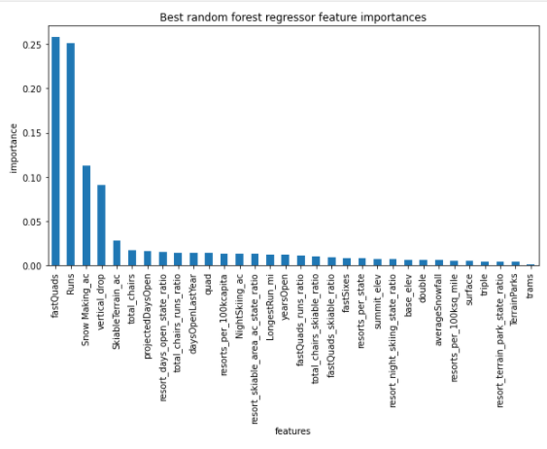
Key Findings
Currently the price for an adult weekday ticket is $81, the modelled price suggests $85.48-95.87.
Adding a run, increasing the max vertical drop by 150 ft, and installing an additional chair lift will correlate with a $1.99 increase. Closing the ten least used runs correlates to a slight price decrease.

Slide 5
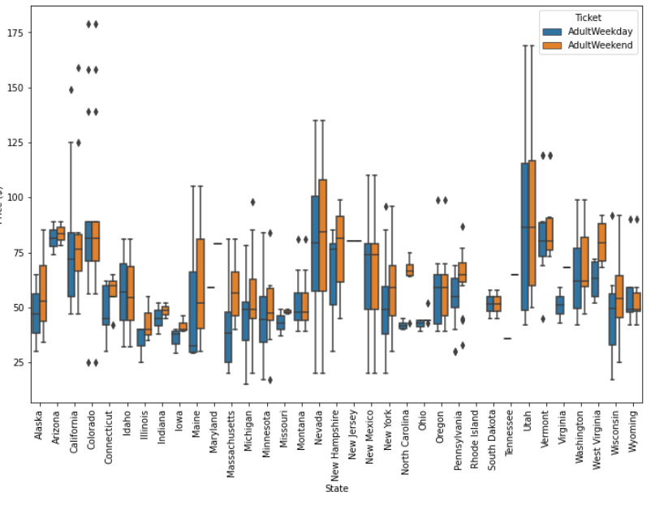
Modeling Analysis
Focus on the ticket prices for adults during the weekdays, features were prioritized based on their effect on the price.

Slide 6
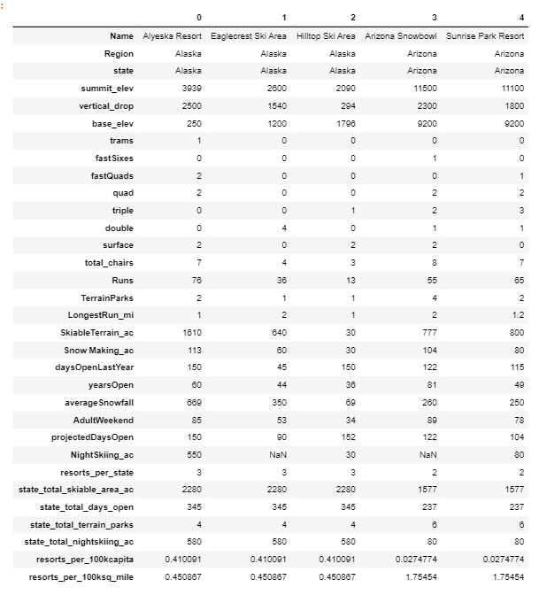
Chosen Factors
Features are engineered by four columns: NightSkiing_ac (skiable acres by night), TerrainParks (# of parks), SkiableTerrain_ac (skiable acres total), and daysOpenLastYear (# of days open previous seaon).
The first five resorts are shown by the resort data and their demographics. The last seven features at the bottom were chosen as important features to examine.

Slide 7
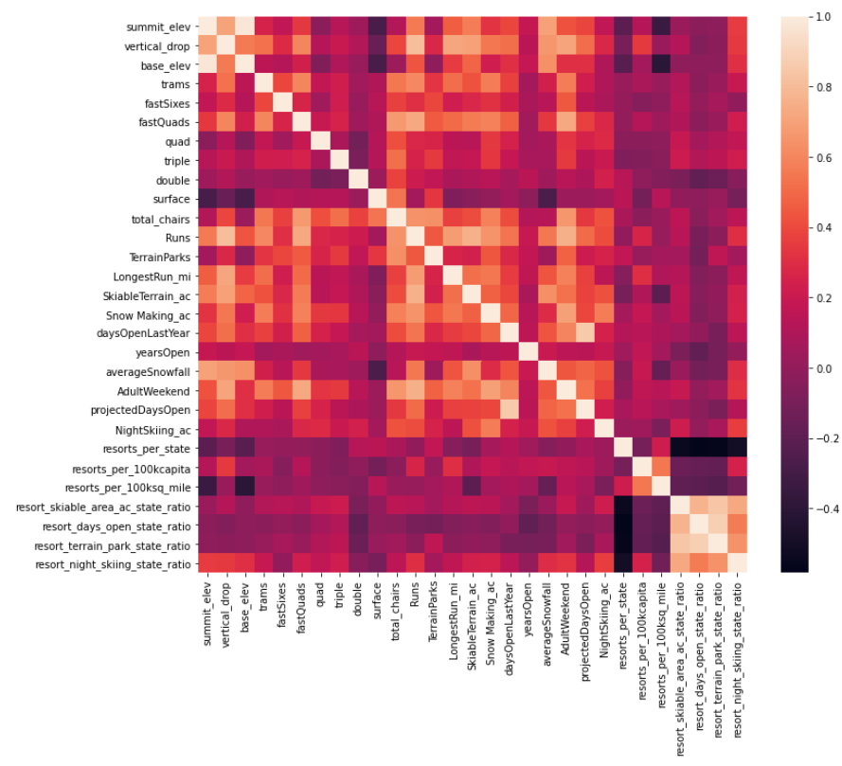
Significant Features
The most significant correlations observed were the fastQuads (4-seater chair lifts), Runs, and Snow Making_ac (snow cover). This is a heatmap showing the correlations between features.

Slide 8
Model Prediction
6 out of 7 of these features dominate 75% of the variance. The most significant features were based on random regressor parameters and trained using the mean of each feature.

Slide 9
Gaining Possibilities
The best model applied suggests that Big Mountain’s modelled price is 95.87 USD, where actual price is 81.00 USD.
Even with the expected mean absolute error of 10.39 USD, this suggests there is room for an increase.
5 USD increase may sum a total of 7.5M USD per year.

Slide 10
Gaining Possibilities (cont.)
Adding a run, increasing the vertical drop by 150 feet, and installing an additional chair lift suggests a $1.99 increase that may sum 3.5M USD per year.
Closing the least used ten runs suggests a slight price decrease.

